Slide 1

Little Miami High School
Freshman Orientation
Class of 2028

Slide 2
Introductions
Administrators:
Dr. Kevin Harleman, Principal
Dr. Chad Huelsman, Assistant Principal
Mrs. Adrienne Sanders, Assistant Principal
Academic/Career Counselors: Student Support Counselors:
Ms. Ashley Brown (A-C & L) Ms. Meredith Reuscher Ms. Brittani Murphy (D-J) Mrs. Amy Anderson Mr. Jared Flanagan (M-So) Beech Acres Support Services Mrs. Brandy Stith (Sp-Z &K) Dr. Mary Kamphaus

Slide 3


New Requirements for Graduation

Slide 4
Credits Required for Graduation
English: 4 credits
Math: 4 credits (Algebra 2)
Science: 3 credits (Physical Science, Biology, Advanced)
Social Studies: 3 credits (World History, American History, Economics, American Government)
Health: ½ credit
Physical Education: ½ credit
Financial Literacy: ½ credit
Fine Arts: 1 credit
Electives: 4 credits
TOTAL = 20.5 credits

Slide 5
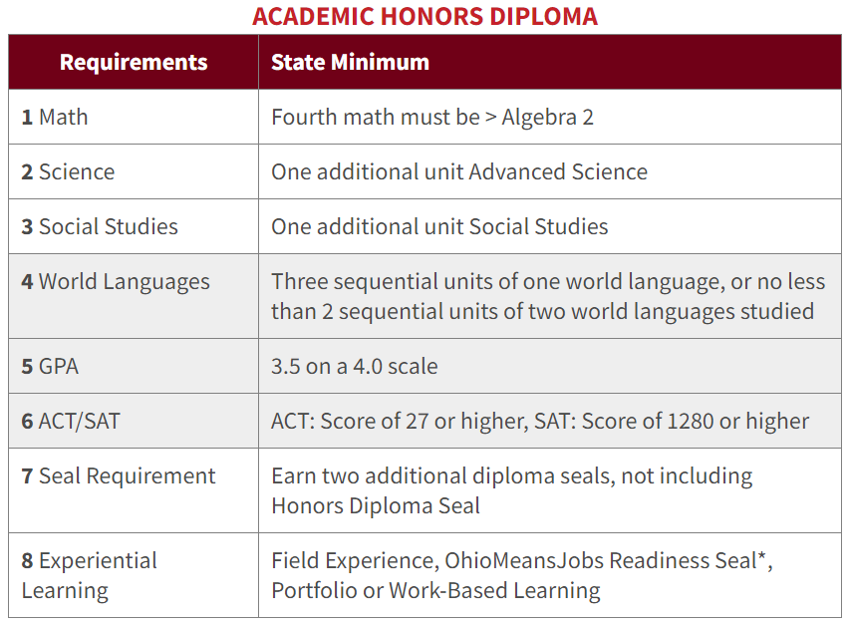
Honors Diploma Requirements
Students must meet all but one of the following criteria:
UNWEIGHTED

Slide 6
Honors Diploma Requirements
Students can use the Student Strength Demonstration to replace one of either the ACT/SAT, GPA or World Language requirement for any Honors Diploma.
OPTIONS:
  College Credit Plus: 12 total College Credit Plus credit hours
  Advanced Placement: three courses with score of 3 or higher on AP tests
  Career-Technical Assurance Guide (CTAG): 12 total credits
  Apprenticeship/Pre-Apprenticeship: Completion or Evidence of Acceptance if required to be older than 18
  WorkKeys: Score of 6 or higher on all tests (*void for Career-Tech Honors Diploma)
  Armed Services Vocational Battery: Score of 50 or above on the ASVAB
  Work-Based Learning: 250 total hours of work-based learning

Slide 7
Weighted Classes
Honors, Advanced Placement (AP)
  .05 added to GPA for passing grades per semester
College Credit Plus (CC+) courses
  .05 or .10 added to GPA for passing grades per semester that is equivalent to weighted courses at the high school.
  Classes 2 credit hours or less = .05
  Classes 3 credit hours or more = .10

Slide 8
College Recommended Courses
4 years of English
4 years of Math
4 years of Science
3 years of Social Studies
2-3 years of Foreign Language
1 year of Fine Arts

Slide 9

Required Courses for 9th grade
English 9 or Honors English 9
Math: Algebra 1, Geometry, Algebra 2, Honors Algebra 1, Honors Geometry, or Honors Algebra 2
Science: Physical Science or Honors Biology
Social Studies: World History, Honors World History, AP World History
Physical Education
Study Hall (Encouraged)

Slide 10
Athletic Eligibility
Must pass 5 one credit classes per year
  PE CLASSES DO NOT COUNT
8th graders must have only passed four credits in the preceding quarter (Quarter 4), and once in high school it's elevated to five
Eligibility checks done quarterly
Each sport will cost $225 during the 2024-25 school year
(For multiple sports and multiple family athletes contact Mr. Louis)
For Athletic Eligibility questions, please contact:
Mr. Matt Louis, Athletic Director (mlouis@lmsdoh.org)
Mr. Rob Mason, Assistant Athletic Director (rmason@lmsdoh.org)
Cindy Evans, Athletics Administrative Assistant (cevans@lmsdoh.org)

Slide 11
Physical Education Requirement
Physical Education (full year)
Summer School PE:
Application and Fee required, more info to come
P.E. Option
  MUST complete two full seasons of a sport
  CANNOT combine P.E. classes and a sport
  MUST be OHSAA sanctioned and offered at LMHS
  MUST complete two full years of Marching Band
Air Force JROTC – 2 years
Kinesiology and Fitness DOES NOT COUNT

Slide 12
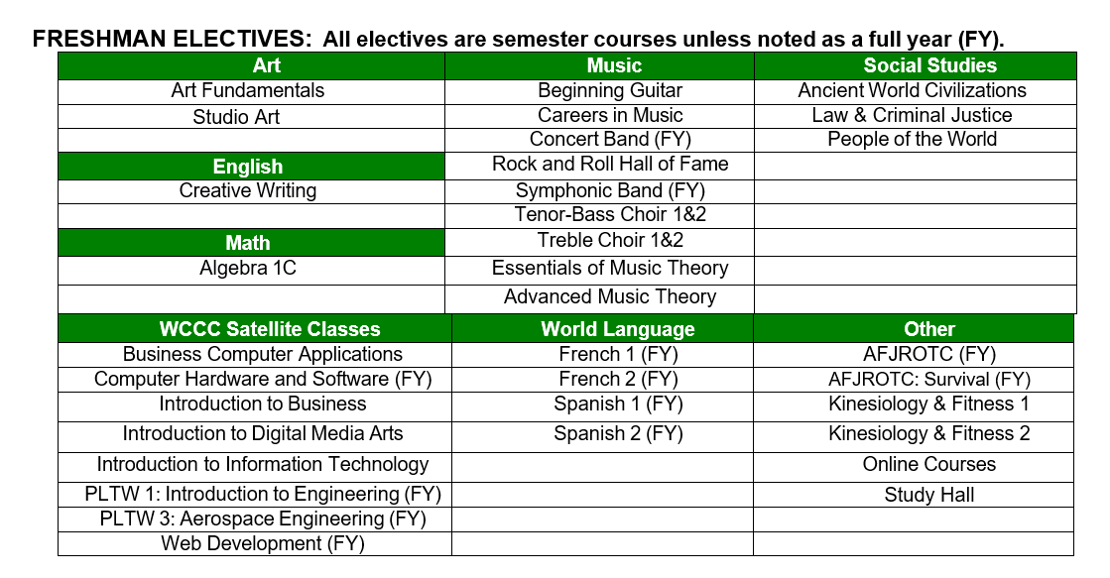
Elective Options

Slide 13
Online Elective Courses
Course descriptions are listed in the Little Miami course guide
Course fee is pending, but will be between $280-$560 per semester class
Course taken during school day
  Self-paced
  Online Teacher
**ONLINE CLASSES MAY NOT BE NCAA APPROVED

Slide 14
Scheduling Process: In-Person Students
All registration forms are due Thursday, February 22 to LMMS social studies teachers.
Counselors meet with students individually on March 25 & March 26 at LMMS.
During these meetings, students will receive Override forms, Online elective class forms, and Summer PE forms.
On March 27 all Override and Online elective class forms are due

Slide 15
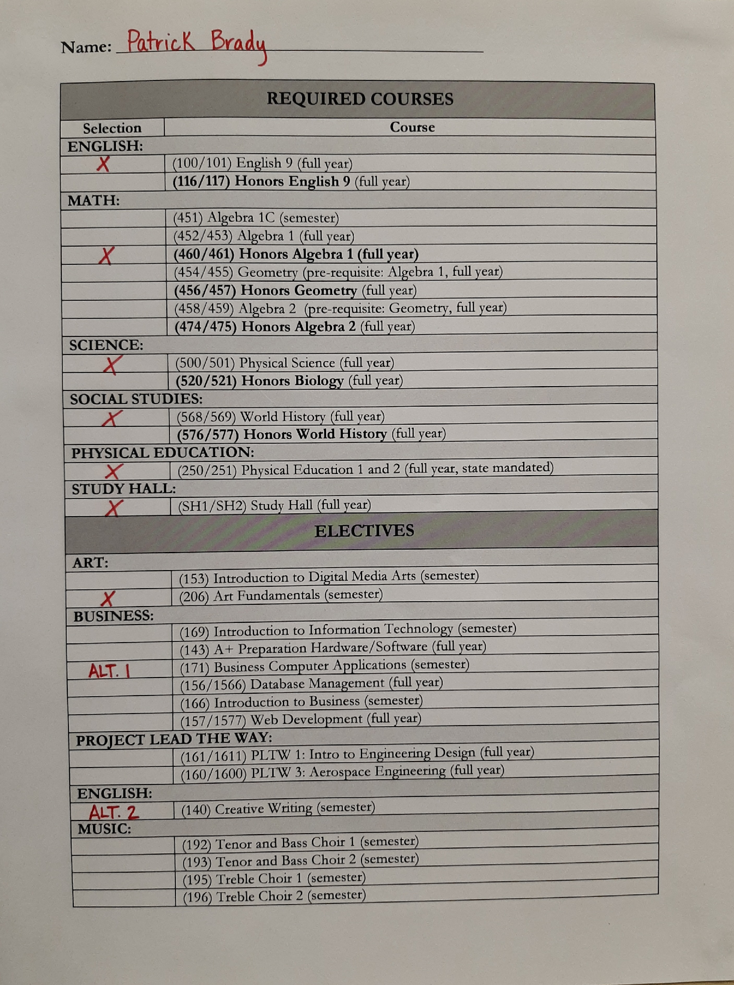
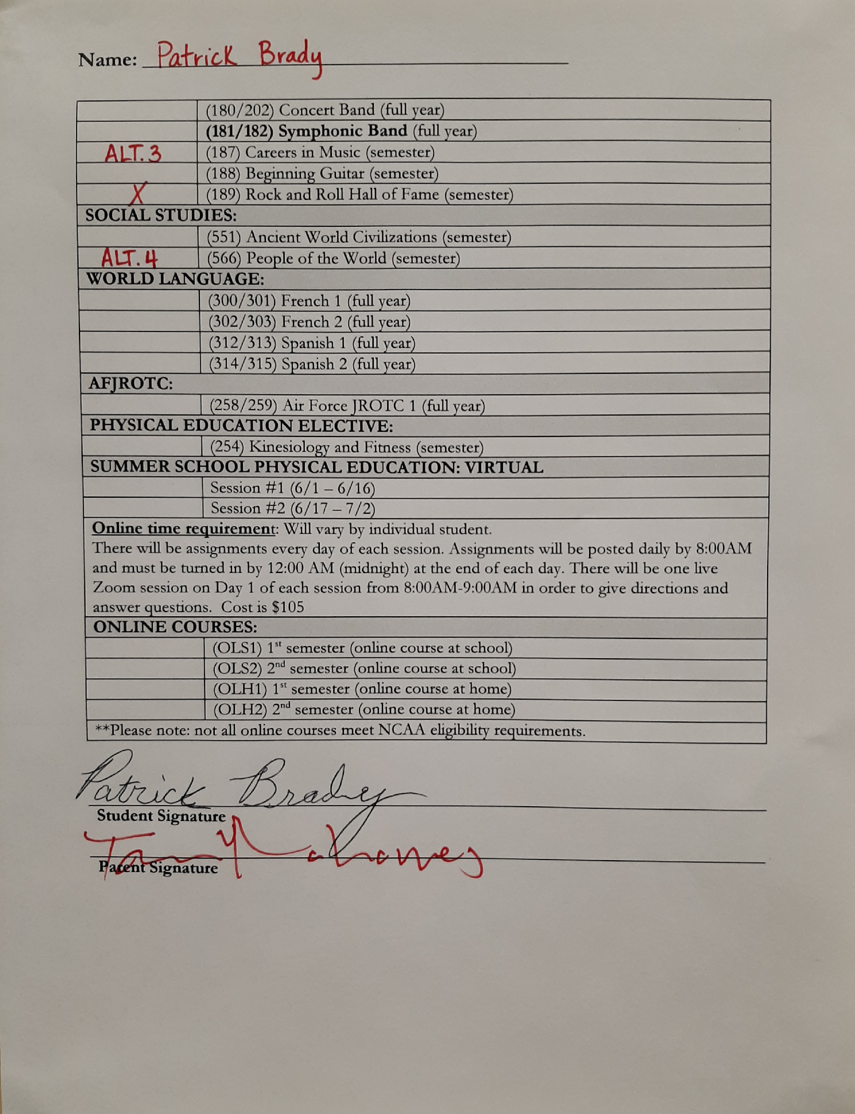
Example Registration Form

Slide 16
Schedule Changes
Student will have five days in the beginning of each semester to change semester-long elective courses.
Class selections will be final at the conclusion of the spring semester, prior to the start of the new school year. If a yearlong course is dropped at any time, the student will receive a Withdrawal Fail on the transcript.

Slide 17
Counselor Contact Information
Ms. Ashley Brown (A-C & L)
abrown@lmsdoh.org
Ms. Brittani Murphy (D-J)
bmurphy@lmsdoh.org
Mr. Jared Flanagan (M-No)
jflanagan@lmsdoh.org
Ms. Brandy Stith (Sp-Z & K)
bstith@lmsdoh.org

